Slide 1
Copyright © 2014 by Software Craftsmanship Guild.
All rights reserved. No part of these materials may be reproduced, distributed, or transmitted in any form or by any means, including photocopying, recording, or other electronic or mechanical methods, without the prior written permission of the Software Craftsmanship Guild. For permission requests, write to the Software Craftsmanship Guild, addressed “Attention: Permissions Coordinator,” at the address below.
Software Craftsmanship Guild
526 S. Main St, Suite 609
Akron, OH 44311

Slide 2
Relationships and Joins
Software Craftsmanship Guild

Slide 3
Lesson Goals
Learn how relational databases eliminate duplicate data
Learn how to walk across table relations to get data from multiple tables

Slide 4
Why Relationships?
There are several goals in mind when we create relationships in databases
To save memory by not replicating the same data repeatedly in a table
To simplify updating relational data
To simply enforcing constraints on the data
The process by which we eliminate duplicate data into separate tables is called normalization
There are 5 normal forms, but most databases stop at the 3rd normal form

Slide 5
1st Normal Form
To be in the 1st Normal Form:
Each table must have a Primary Key that uniquely identifies a record.
The values in each column must be atomic (no multi-value attributes)
There are no repeating groups: Two columns don’t store similar information in the same table

Slide 6
Example of Going to 1st Normal Form
Take for example the table below:
What if two people share the same name?
How would we uniquely identify them?
Since there is no primary key, this is referred to as a heap
FirstName | LastName | Telephone
Eric | Wise | 555-1234
Jenny | GotYourNumber | 867-5309

Slide 7
A Primary Key Must be Unique
Most of the time, we use an auto-number or a GUID (globally unique identifier) to create a surrogate key (a key not based on the entity’s data). The database can generate and manage these when we create rows
PersonID | FirstName | LastName | Telephone
1 | Eric | Wise | 555-1234
2 | Jenny | GotYourNumber | 867-5309

Slide 8
But what if we need to store more than one phone number?
Oftentimes requirements dictate that we store more than one phone number or keep a history of phone numbers. Inexperienced people want to do this:
PersonID | FirstName | LastName | Home | Mobile
1 | Eric | Wise | 555-1234 | 555-2345
2 | Jenny | GotYourNumber | 867-5309 | 111-2222

Slide 9
But normalization suggests we should move phone to another table
PersonID | FirstName | LastName
1 | Eric | Wise
2 | Jenny | GotYourNumber
PhoneID | PersonID | Number | Type
1 | 1 | 555-1234 | Home
2 | 1 | 555-2345 | Mobile
3 | 2 | 867-5309 | Home
4 | 2 | 111-2222 | Mobile

Slide 10
2nd Normal Form
We successfully satisfied 1st Normal Form, but now we have duplicate information across rows
2nd Normal Form Requires:
1st Normal Form
Redundant data across multiple rows must be moved to a separate table and joined by a key

Slide 11
Going 2nd Normal Form
PhoneID | PersonID | Number | PhoneTypeID
1 | 1 | 555-1234 | 1
2 | 1 | 555-2345 | 2
3 | 2 | 867-5309 | 1
4 | 2 | 111-2222 | 2
PhoneTypeID | TypeName
1 | Home
2 | Mobile

Slide 12
3rd Normal Form
To reach 3rd Normal Form:
First two forms must be met
Eliminate any field that does not depend on the primary key:
This means any field which is not dependent on the primary key but on another field must be moved
Most databases don’t go this far

Slide 13
3rd Normal Form Example
Tournament | Year | Winner | WinnerDOB
Indiana Invitational | 1998 | Al Fredrickson | July 21st, 1975
Cleveland Open | 1999 | Bob Albertson | Sept 28th, 1968
Des Moines Masters | 1999 | Al Fredrickson | July 21st, 1975
Indiana Invitational | 1999 | Chip Masterson | Mar 14th, 1977
Here tournament and year are a candidate for a key since they are unique, but the winner’s date of birth is dependent on the winner name, not the tournament. So 3rd normal form would have us move the winner and DOB to a new table.

Slide 14
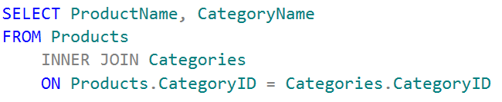
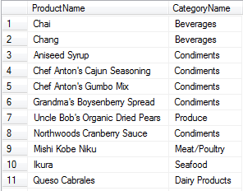
Now that we’ve split all the data up…
We need some joins!
The first join is the INNER JOIN. It allows us to join the data of two tables on a matching key.
INNER JOIN only returns rows where the key in both tables is an exact match.
For the INNER JOIN to work we have to specify which tables and what field in each table to join on.
Typically in a good data model the join columns will be named the same, so we have to qualify the match with the table names.

Slide 15
Foreign Keys
In the previous example the CategoryID on Categories is the primary key, but it also exists on the Products table as a Foreign Key
SQL Server will not allow a Product record to contain a CategoryID that does not exist in the Categories table. This is called Referential Integrity, and it prevents invalid data from getting into the table.
If a foreign key is not null, it must be provided and match. If it is null, it is allowed to be empty, but if it has a value it must have a matching key.
We don’t have to join on foreign keys, we can join on any condition, but a good data model you typically will (and the DBA will optimize the lookups for these matches)

Slide 16
Note About Inner Joins
Keep in mind that if the join column is null in the adjoining table the record will not be displayed in the result set! They must be an exact match!

Slide 17
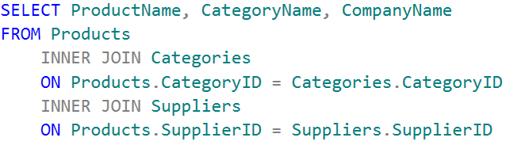
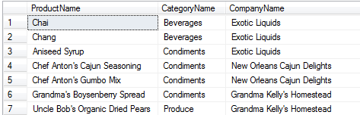
We can join almost (256) as many tables as we like

Slide 18
Lab Exercises
Get a list of each employee and their territories
Get the Customer Name, Order Date, and each order detail’s Product name for USA customers only.
Get all the order information where Chai was sold.

Slide 19
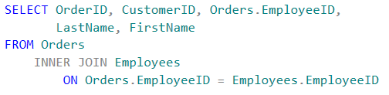

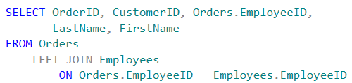

LEFT JOINS
Whereas an inner join matches on exact matches, a left join contains all records from the left table and only matching records in the right table.
Say for instance an internet order has no EmployeeID assigned to it
If we inner join orders to employee, the internet records will be excluded because there is no match.
If we left join from orders we would get all of the orders regardless of having an employee attached.
Right joins are the same as left joins, except reversed.

Slide 20
Full Outer Joins
Full outer joins are the combination of left and right joins. It is the equivalent of saying “give me all rows from both tables regardless of whether they match”
Non matching records in either table will have nulls for the other table’s columns

Slide 21
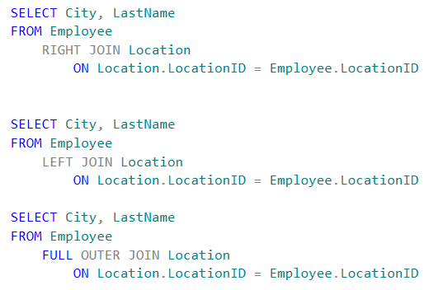
SWC Corp Employee Locations
Run the following queries to see the difference between left, right, and full outer joins

Slide 22
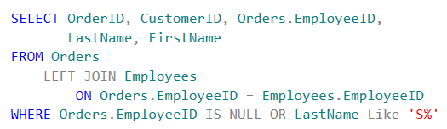
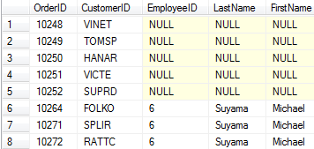
Filtering on Nulls
(northwind) To filter on nulls simply use the IS NULL or IS NOT NULL predicate:

Slide 23
Fin
Next up- Query Writing Strategies!

